Slide 1
OpenStack – Cloud operating system

Slide 2
OpenStack
First came into existence on July 21′ 2010. It was a joint project of Rackspace Hosting and NASA to make cloud computing more ubiquitous in nature.
It is deployed as Infrastructure-as-a-service(IaaS) in both public and private clouds.
OpenStack is a cloud operating system that controls large pools of compute, storage, and networking resources throughout a datacenter.
All managed and provisioned through APIs with common authentication mechanisms.

Slide 3
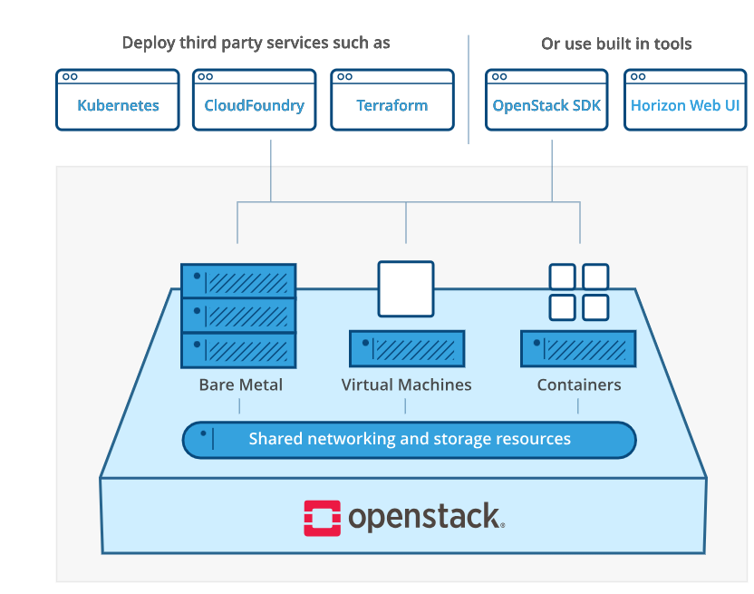

Slide 4
Principles of OpenStack
Open Source: Under the Apache 2.0 license, OpenStack is coded and published. Apache allows the community to use it for free.
Open Design: For the forthcoming update, the development group holds a Design Submit every 6 months.
Open Development: The developers maintain a source code repository that is freely accessible through projects like the Ubuntu Linux distribution via entig100s.
Open Community: OpenStack allows open and transparent documentation for the community.

Slide 5
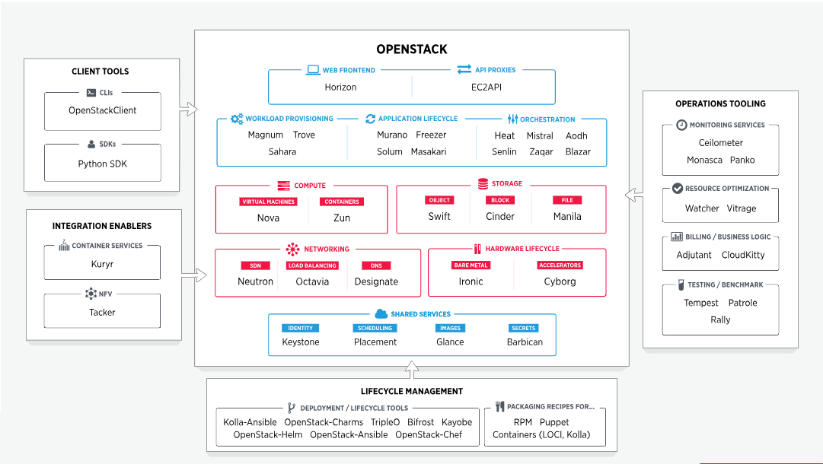
OpenStack Map

Slide 6
How does OpenStack work
OpenStack is essentially a series of commands known as scripts.
Those scripts are bundled into packages called projects that relay tasks that create cloud environments.
In order to create those environments, OpenStack relies on 2 other types of software:
Virtualization that creates a layer of virtual resources abstracted from hardware
A base operating system (OS) that carries out commands given by OpenStack scripts

Slide 7
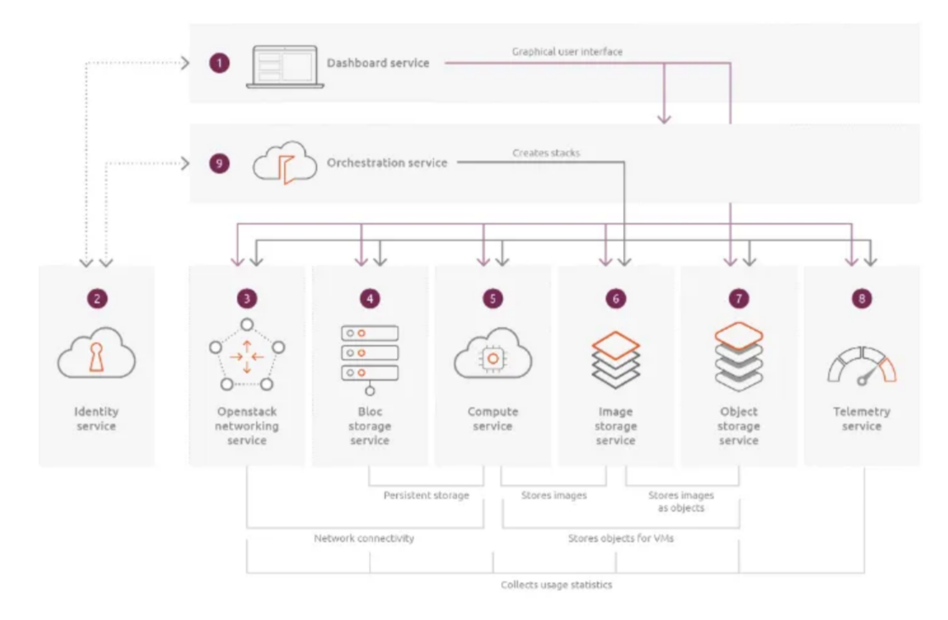

Slide 8
OpenStack Components
Nova (compute service): Nova is a full management and access tool to OpenStack compute resources—handling scheduling, creation, and deletion.
Neutron (networking service): It is responsible for connecting all the networks across OpenStack. It is an API driven service that manages all networks and IP addresses.
Swift (object storage): Swift is a highly fault-tolerant object storage service that stores and retrieves unstructured data objects using a Restful API.
Cinder (block storage): It is responsible for providing persistent block storage that is made accessible using an API (self- service). Consequently, it allows users to define and manage the amount of cloud storage required.

Slide 9
OpenStack Components
Keystone (identity service provider): It is responsible for all types of authentications and authorizations in the OpenStack services. It is a directory-based service that uses a central repository to map the correct services with the correct user.
Glance (image service provider): It is responsible for registering, storing, and retrieving virtual disk images from the complete network. These images are stored in a wide range of back-end systems.
Horizon (dashboard): It is responsible for providing a web-based interface for OpenStack services. It is used to manage, provision, and monitor cloud resources.
Ceilometer (telemetry): It is responsible for metering and billing of services used. Also, it is used to generate alarms when a certain threshold is exceeded.
Heat (orchestration): It is used for on-demand service provisioning with auto-scaling of cloud resources. It works in coordination with the ceilometer.

Slide 10
OpenStack Services
Object Storage: OpenStack Object Storage (Swift) is a highly scalable, distributed object storage system.
Compute: OpenStack Compute (Nova) is a cloud computing fabric controller, which manages the allocation of compute resources.
Networking: OpenStack Networking (Neutron) is a system for managing networks and IP addresses.
Dashboard: The OpenStack Dashboard (Horizon) is a web-based interface for managing OpenStack resources.
Identity: OpenStack Identity (Keystone) is a system for managing user accounts and access control.
Image: OpenStack Image (Glance) is a service for storing and retrieving virtual machine images.
Block Storage: OpenStack Block Storage (Cinder) is a service for managing block storage devices.
Telemetry: OpenStack Telemetry (Ceilometer) is a service for collecting and storing metering data.
Orchestration: OpenStack Orchestration (Heat) is a service for orchestration and cloud formation.
Bare Metal: OpenStack Bare Metal (Ironic) is a service for provisioning and managing bare metal servers.
Data Processing: OpenStack Data Processing (Sahara) is a service for provisioning and managing Hadoop and Spark clusters.

Slide 11
Features of OpenStack
Modular architecture: OpenStack is designed with a modular architecture that enables users to deploy only the components they need. This makes it easier to customize and scale the platform to meet specific business requirements.
Multi-tenancy support: OpenStack provides multi-tenancy support, which enables multiple users to access the same cloud infrastructure while maintaining security and isolation between them. This is particularly important for cloud service providers who need to offer services to multiple customers.
Open-source software: OpenStack is an open-source software platform that is free to use and modify. This enables users to customize the platform to meet their specific requirements, without the need for expensive proprietary software licenses.

Slide 12
Features of OpenStack
Distributed architecture: OpenStack is designed with a distributed architecture that enables users to scale their cloud infrastructure horizontally across multiple physical servers. This makes it easier to handle large workloads and improve system performance.
API-driven: OpenStack is API-driven, which means that all components can be accessed and controlled through a set of APIs. This makes it easier to automate and integrate with other tools and services.
Comprehensive dashboard: OpenStack provides a comprehensive dashboard that enables users to manage their cloud infrastructure and resources through a user-friendly web interface. This makes it easier to monitor and manage cloud resources without the need for specialized technical skills.
Resource pooling: OpenStack enables users to pool computing, storage, and networking resources, which can be dynamically allocated and de-allocated based on demand. This enables users to optimize resource utilization and reduce waste.

Slide 13
OpenStack | AWS
OpenStack is categorized as Cloud Management Platforms and Infrastructure as a Service (IaaS). | AWS Lambda is categorized as a Cloud Platform as a Service (PaaS).
Glance handles the images. | AMI (Amazon Machine Image) handles the images.
LBaaS of OpenStack handles the load balance traffic. | The ELB (Elastic Load Balancer) automatically distributes the incoming traffic from the services to the EC2 instances.
Each virtual instance will automatically be allocated an IP address. It is handled by DHCP. | AWS allocates a private IP address to every new instance using DHCP.
Identity authentication services are handled by Keystone. | Identity authentication services are handled by IAM Identity and Access management.
Swift handles object storage. | Object storage is managed by S3 (simple storage service) bucket
A cinder component manages block storage. | Block storage is managed by EBS (Elastic Block Storage)
OpenStack provides MYSQL and PostgreSQL for the relational databases. | Users of AWS use an instance of MySQL or Oracle 11g.
OpenStack uses MongoDB, Cassandra, or Couchbase for a non-relational database. | For a non-relational database, AWS uses EMR (Elastic Map Reduce).
For networking, OpenStack uses Neutron. | For networking, AWS uses VPC (Virtual Private Cloud).
Machine learning (ML) and NLP (Natural Language processing) are not readily available. | Machine Learning (ML) and NLP (Natural Language processing) are possible in AWS.
OpenStack has no Speech or Voice recognition solution. | Lex is used for speech or voice recognition solutions.
It has the Mistral - Workflow Service. | It follows the Simple Workflow Service (SWF).
Ceilometer - the Telemetry based billing, resource tracking etc. | AWS Usage and the Billing Report.
No Serverless Framework. | Lambda is a serverless framework.

Slide 14
Benefits of OpenStack
Open Source
Scalability
Security
Automation
Easy to Access and Manage
Services
Strong Community
Compatibility

Slide 15
Advantages of using OpenStack
It boosts rapid provisioning of resources due to which orchestration and scaling up and down of resources becomes easy.
Deployment of applications using OpenStack does not consume a large amount of time.
Since resources are scalable therefore they are used more wisely and efficiently.
The regulatory compliances associated with its usage are manageable.

Slide 16
Disadvantages of using OpenStack
OpenStack is not very robust when orchestration is considered.
Even today, the APIs provided and supported by OpenStack are not compatible with many of the hybrid cloud providers, thus integrating solutions becomes difficult.
Like all cloud service providers OpenStack services also come with the risk of security breaches

Slide 17
Installation and Configuration of OpenStac

